Slide 1
HOTEL BOOKING MANAGEMENT
MANOJ KARRU
ROHITH NAGABHIRAVA
RAMA KRISHNA

Slide 2
INTRODUCTION
The purpose of this database is to maintain the data used to generate and support hotel booking management.

Slide 3
List of tables
List_of_Cities.
List_of_Hotels
Hotel_Amenities.
List_of_Amenities.
Hotel_Rooms.
Room_selection.
Seasonal_Pricing.
Period_Room_Rates.
Room_Types.
Room_Selection.
Customer_Details.
Hotel_Booking.
Payment_Details.
Discount_Coupons.

Slide 4
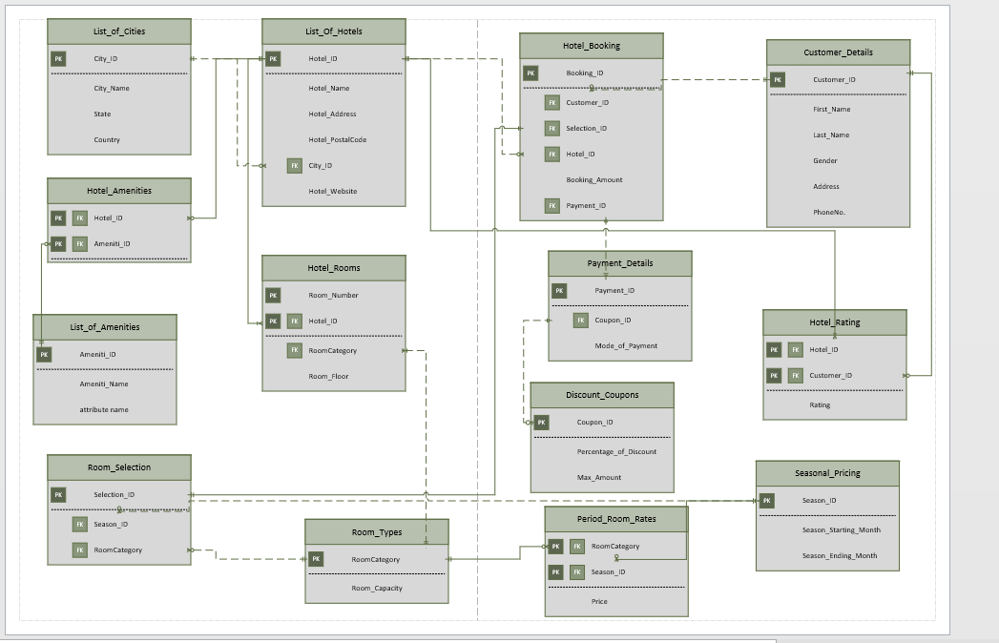
ERD diagram

Slide 5
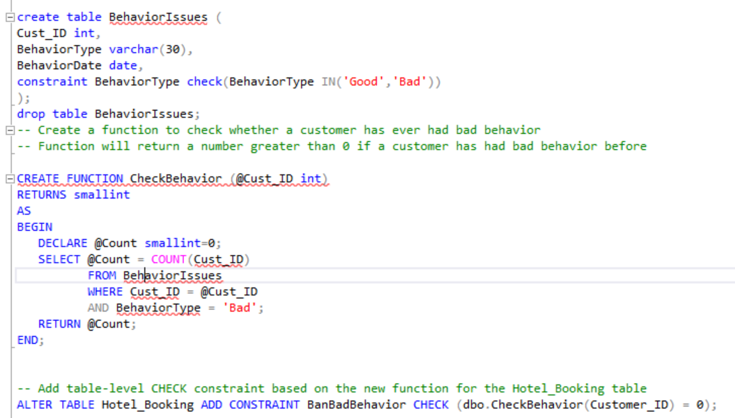
TABLE LEVEL CHECK CONSTRAINT
In the process of implementing a business rule we have used the table level check constraint on Hotel_Booking table.

Slide 6
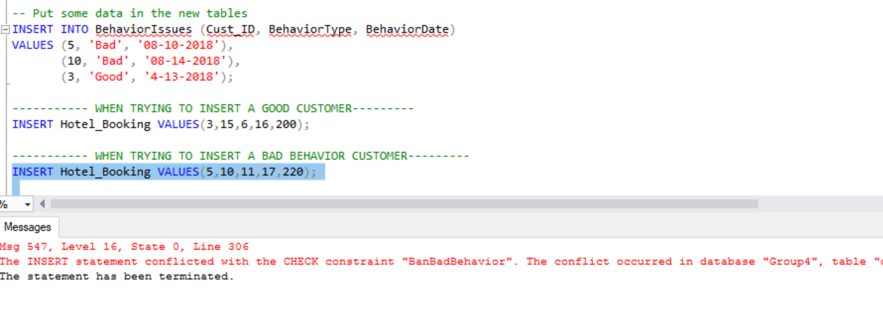
TABLE LEVEL CHECK CONSTRAINT
When you try to insert a customer who had previous behavior issues.

Slide 7
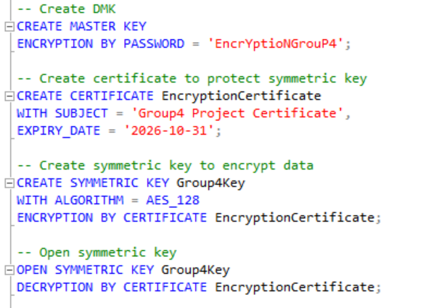
Column data encryption
We need to keep some sensitive information like password and other information of customers protected.
To achieve this we have encrypted some columns of Customer_Details table.

Slide 8
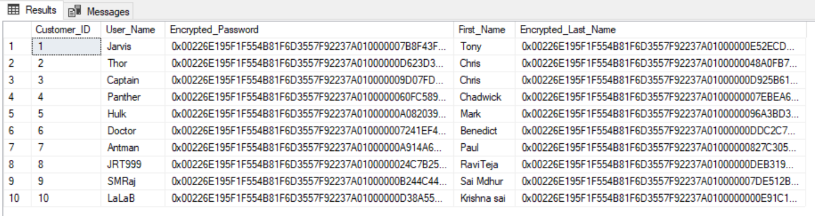
Column data encryption
The result of encryption is as follows.

Slide 9
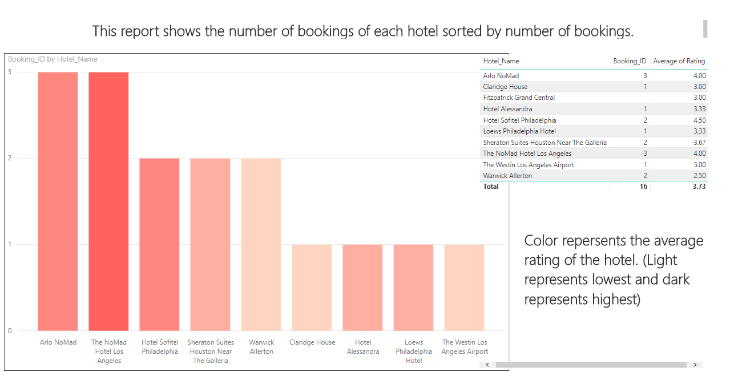
Power bi

Slide 10
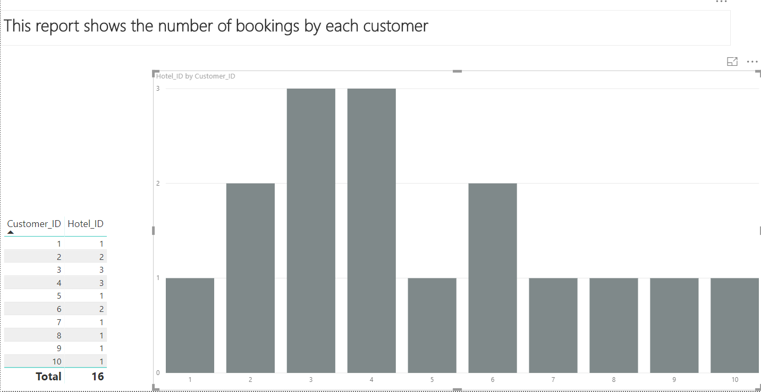
Power bi

Slide 11
THANK YOU

Slide 12
questions!!!

